Slide 1
Rainfall prediction with machine learning
Parth Sharma, Aabhas Garg

Slide 2
Introduction
Rainfall prediction could be considered one of the oldest and important prediction problems in human history.
Rainfall prediction rely on several different factors such as humidity, temperature, location, wind direction etc.
The accuracy of the results have lot of economic and human impacts.
Improved predictions can help in a lot of fields such as agriculture, construction, sports, disaster management etc.
Machine learning algorithms are required to be tested and trained and compared to find the best results.

Slide 3
Closely related work
Various research has been done on rainfall prediction some of them we studied and cited in our paper:
In a recent paper published in Ain Shams Engineering journal a case study of Terengganu, Malaysia was done. Various machine learning methods are used, and a comparative study is done based on the results and an efficient model was developed.
In a paper published in 2013 in international journal of engineering research and technology, a model of rainfall prediction was made based on data mining principles which was dynamic in nature.
In a paper published in 2016 in International Journal of Computer Application, a vivid descriptive study of different rainfall prediction studies was done

Slide 4
Proposed Methodology
The following slides will describe the methodology we propose as a solution to our problem.

Slide 5
Data Preprocessing
First the fata is explored to find the number of features and data rows.
The target variables are converted from yes/no to binary.
The data is checked for imbalances and then it is balanced.
Now, the missing values are checked.
Now the columns are imputed and converted to binary values using label encoding.
A correlation matrix is formed to check for collinearity and a pair plot is created to check overlapping clusters.
Finally, the best features are selected using filter and wrapper methods.

Slide 6
Training and testing
The data is separated as 75% for training and 25% for testing.
The features are normalized using standard scaler.
The various scores are defined and initialized
The models i.e., Logistic regression, Decision Tree, Random forest Neural Network, Random Forest, LightGBM, CatBoost, XGBoost, GaussianNB are imported trained and tested by calculating the scores.
Then the models are compared using various graphs.

Slide 7
Experimental results
The different models performed differently on the scores that we used that are Accuracy, Roc Area under Curve, Cohen’s Kappa and Time Taken.
The following slide will discuss the results.

Slide 8
ResultS
Linear regression gives the least accuracy, Area Under the Roc, Cohen’s Kappa. The only benefit shown is the time taken which is the least.
For decision tree, the accuracy improved over linear regression as it is a more accurate algorithm and so did the other scores. The time taken is increased due to the complexity of the algorithm.
For Neural Network, the accuracy improved compared to previous algorithms. It performs well in other tests as well. The time taken is very high so, it requires better processing power.
Random foresting is efficient and a very accurate algorithm for large data that’s why the accuracy score is very high as so are the other scores. The time taken is more.
The Light GMB performs good in accuracy score and time. It is a quick and efficient algorithm.
The accuracy is very high and so is the Roc are under the curve. Cohen’s Kappa is also high which means more reliability. It is slow to process.
XGBoost is an efficient algorithm designed for speed and performance and hence it performs the best at accuracy and comparatively better at time taken than other complex algorithms. The other scores the best too
We used Gaussian Naïve Bayes algorithm which performed fine but didn’t worked well with our data. So, the scores were pretty low

Slide 9
Findings of the project
A comparative study of the results found after training and testing are the findings of our project which is explained in the following slides.

Slide 10
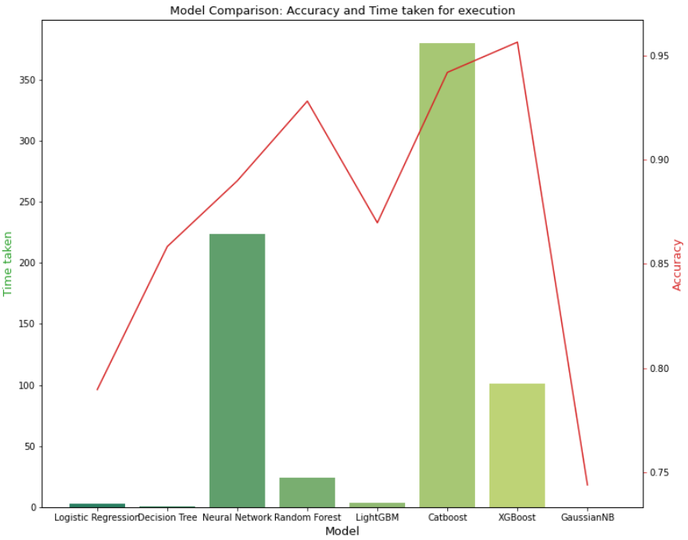
Comparison of Accuracy and Time Taken
1. The Graph clearly shows that the most accurate algorithm is XGBoost.
2.The Best performing algorithms are XGBoost, CatBoost and Random Forest.
3. The fastest algorithms are Logistic regression and Gaussian Naïve Bayes.

Slide 11
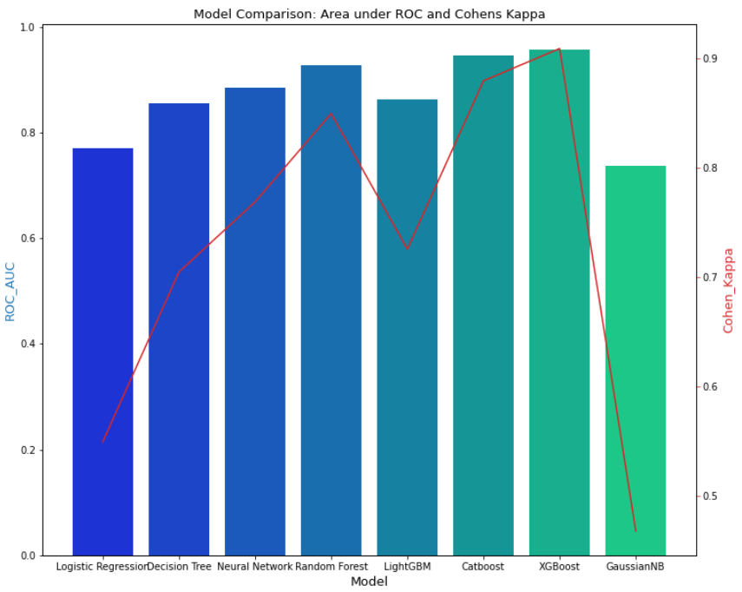
Comparison Of Area Under ROC and Cohen’s Kappa
1. The best scores are obtained by XGBoost, CatBoost.
2. Area Under the ROC measures the usefulness of the algorithm and Cohen’s Kappa measure the reliability.

Slide 12
Conclusion
Rainfall prediction is a simple yet complicated task. Many supervised models can be applied for the prediction.
This research provides the analysis of seven different algorithms.
The data preprocessing steps are also explained which are important for the understanding of the research.
Rainfall prediction technology continue to evolve and improve with time.
With more processing power more complex algorithms can be used over larger data and hence it is important to employ new algorithms for this problem to serve the population.

Slide 13
references
[1] Ridwan, Wanie M., et al. "Rainfall forecasting model using machine learning methods: Case study Terengganu, Malaysia." Ain Shams Engineering Journal 12.2 (2021): 1651-1663.
https://www.sciencedirect.com/science/article/pii/S2090447920302069
[2] Gaikwad, Ganesh P., and V. B. Nikam. "Different rainfall prediction models and general data mining rainfall prediction model." Int. J. Eng. Res. Technol 2 (2013): 115-123.
[3] Hirani, Dhawal, and Nitin Mishra. "A survey on rainfall prediction techniques." International Journal of Computer Application 6.2 (2016): 28-42.

